Slide 1
Building Excellence Presentation
Community Engagement
April 2012

Slide 2
Tonight’s Agenda
Tonight we will share:
Our current situation on safety, enrollment growth, capacity and building condition in our schools
Our preliminary options for projects funded which would be funded through our next Building Excellence (BEX) levy
We will conclude by asking you about three things:
Which option, without changes, most closely represents what you believe is the best way to go?
Are there any changes you would make to strengthen your preferred option?
After seeing costs, what is your initial level of support for each option?

Slide 3
The BEX IV Levy Process
A 25-member Facilities and Capacity Management Advisory Committee (FACMAC) has been reviewing enrollment and school capacity data to advise the Superintendent
A BEX Oversight Committee advises the Board on construction related projects and finances
Community input will be sought via public meetings and surveys during April and September (SEPA public meeting April 11)
Additional planning information (updated enrollment projections, program recommendations) by June
The School Board votes on the final list of projects in October 2012
BEX IV Levy Vote: February 2013

Slide 4
The Current Situation
Seattle Public School District is growing!
Current projections show between 1,000 to 1,500 additional students per year
We’re especially crowded in the north and southwest regions of our district
We need to address this capacity issue by reopening closed schools, remodeling existing schools, and building new schools
Previous community feedback has included “reduce portable use” as a long term solution

Slide 5
2010 vs. 2011 Enrollment
Grades | 2010-11 Enrollment | 2011-12 Enrollment | Change from 2010-11
K-5 | 24,104 | 24,958 | +854
6-8 | 9,603 | 9,986 | +383
9-12 | 13,301 | 13,552 | +251
Total | 47,008 | 48,496 | +1,488
Adjusted October headcounts
Notes:
Rachel

Slide 6
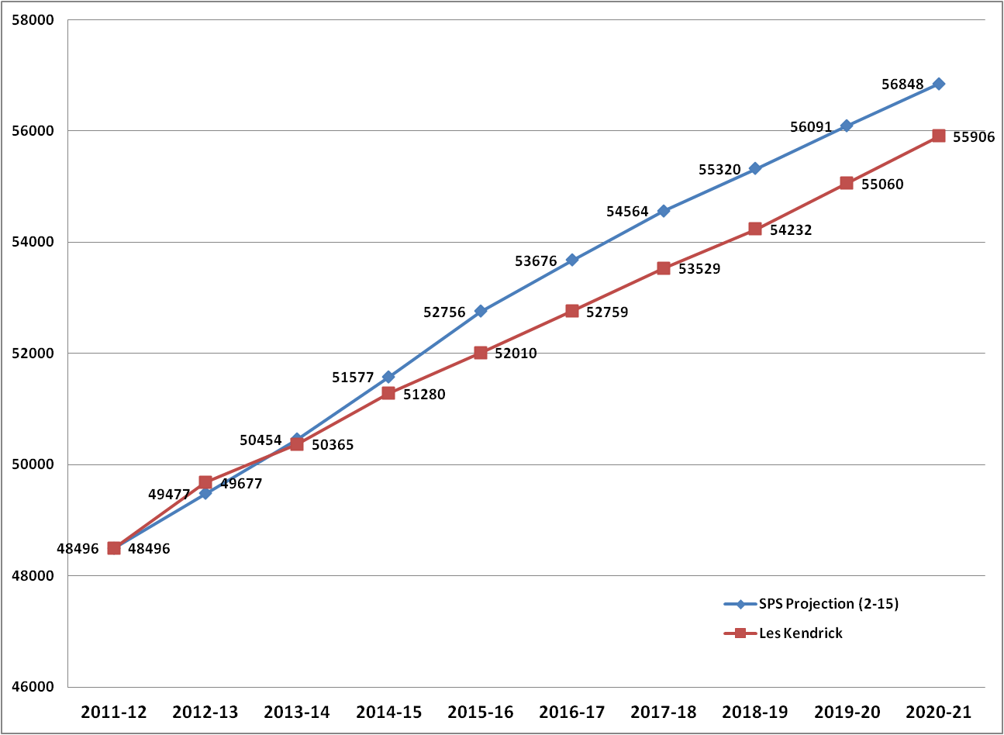
Extended District Enrollment Projections
SPS and Les Kendrick (consultant)

Slide 7
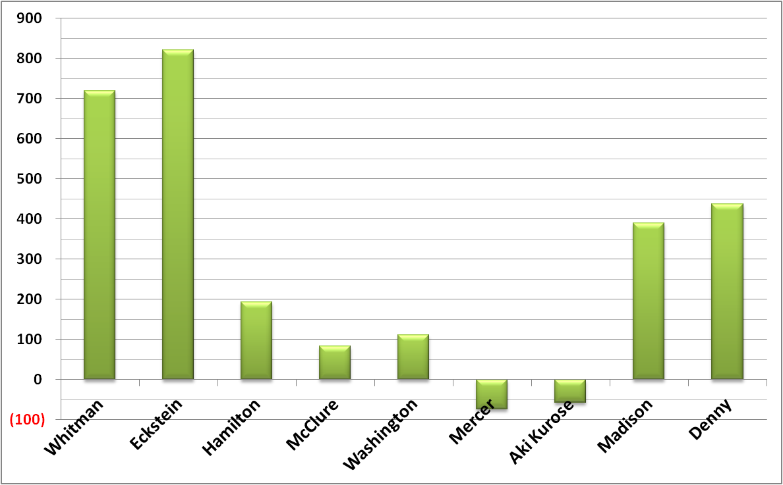
Additional Seats Needed by 2020
Elementary Level
Note: Negative numbers indicate excess capacity

Slide 8
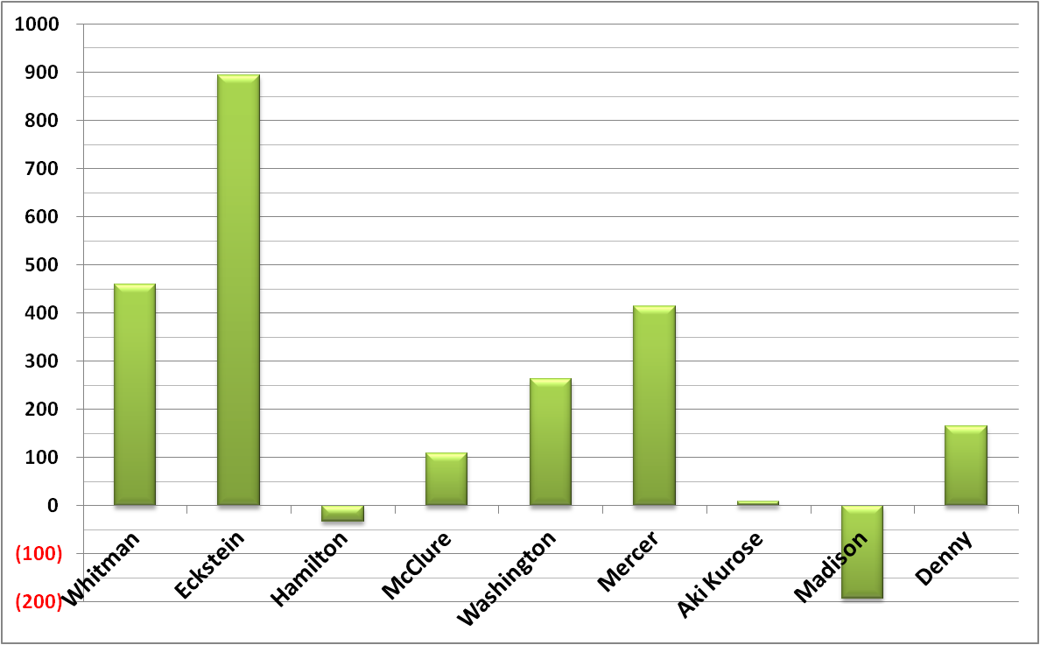
Additional Seats Needed by 2020
Middle School Level
Note: Negative numbers indicate excess capacity

Slide 9
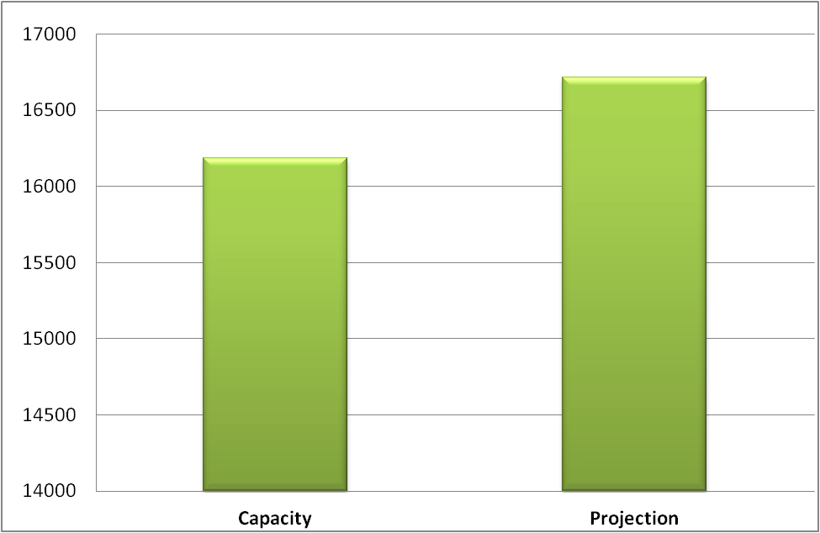
Additional Seats Needed by 2020
High School Level

Slide 10
Before We Go Further … Some Additional Context
How past BEX/BTA funds, by region, have been spent
Key criteria used for determining project
How the BEX IV levy funding works

Slide 11
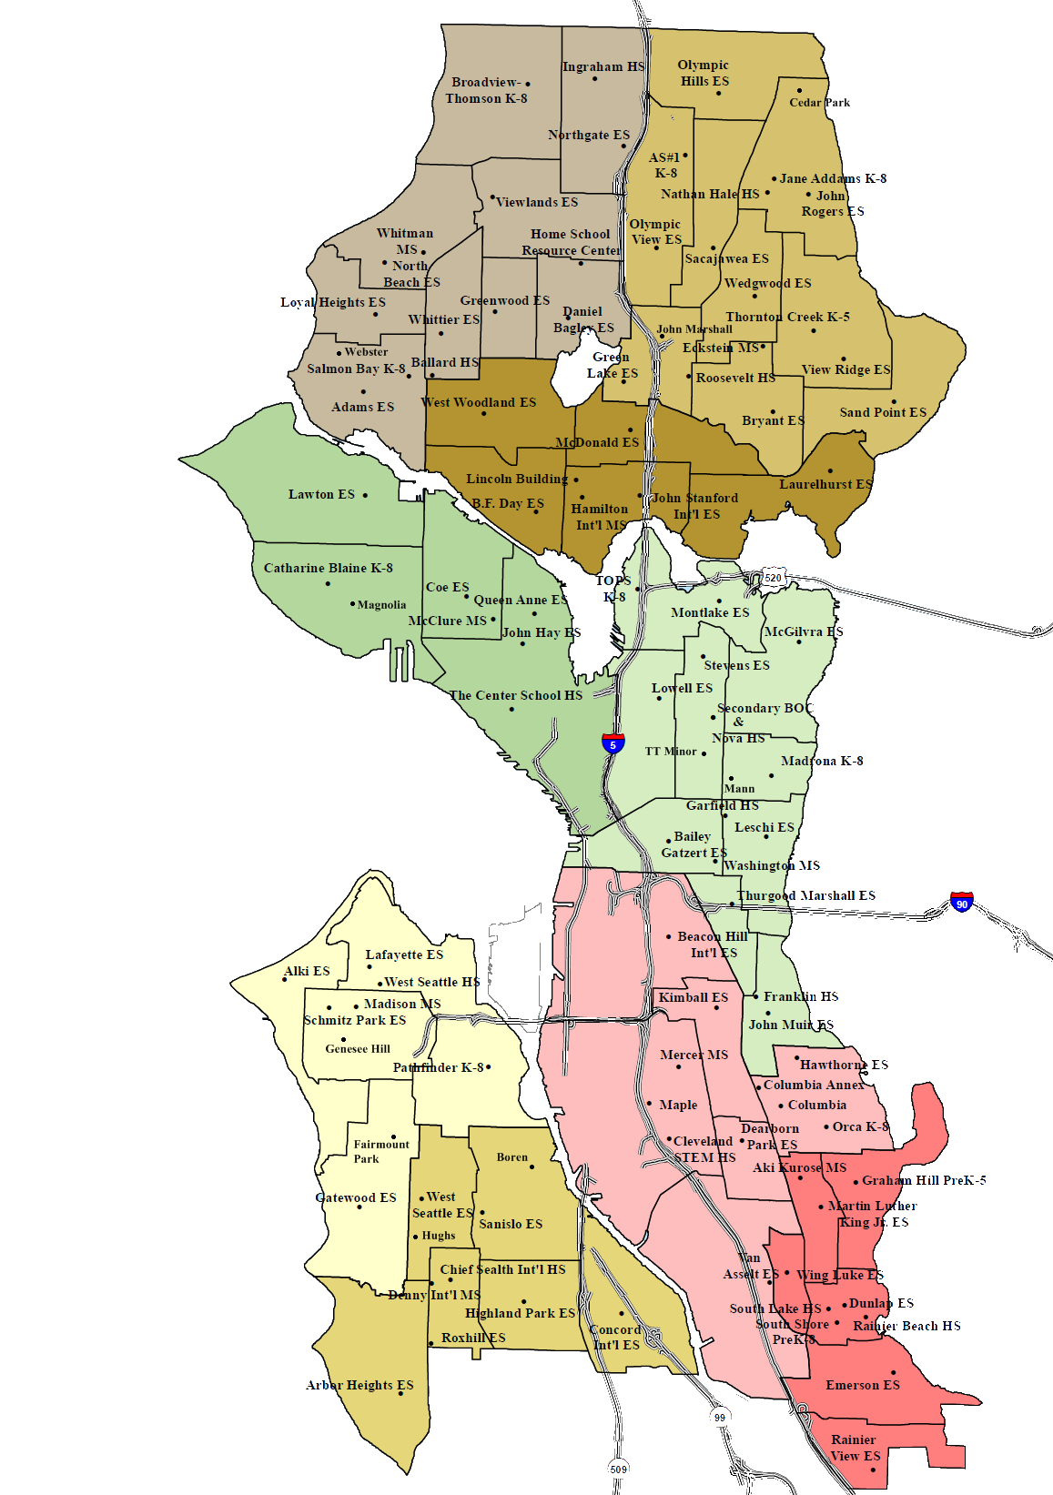
Where We Have Spent Past BEX/BTA Funds
North Region %
of Total
BEX & BTA I , II & III
37%
Central Region %
of Total
BEX & BTA I, II & III
18%
South West Region %
of Total
BEX & BTA I, II & III
22%
South East Region %
of Total
BEX & BTA I, II & III
23%

Slide 12
Criteria for Determining Specific Projects Within BEX IV
Potential projects are selected using four important criteria:
Health, safety and security
Capacity
Building condition
Minimize disruption to students; maximize flexibility for program placement

Slide 13
How BEX IV Works
The levy would replace the current six-year
BEXIII Levy (expires in 2013)
Taxes would be collected over a six-year period starting in 2014 and ending in 2020
Unlike bonds, a capital levy does not incur any interest expense; it’s ‘cash as you go’

Slide 14
BEX IV Levy – What Would It Cost? Note: figures below are estimated based on preliminary data; for illustration purposes only
Homeowner cost based on 2011 average home value = $453,000*
Annual Cost Additional cost
per homeowner Per Year
BEX III Current - $490M $317 0
Option 1: BEX IV - $528M $321 $4
Option 2: BEX IV - $700M $426 $109
Option 3: BEX IV - $892M $542 $225
*$453,000 is 2011 average residential value for Seattle School District as stated in the 2012 King County Assessor’s Annual Report

Slide 15
BEX IV – Three Options
Addresses capacity needs
Option 1: does not eliminate homeroom portables
Option 2: cuts down homeroom portables at elementary level by almost half
Option 3: eliminates most portables in grades K-8

Slide 16
Schools Affected by Major Projects in BEX IV Options
Notes:
Go over handout of three options

Slide 17
Your Feedback
Which option, without changes, most closely represents what you believe is the best way to go?
Are there any changes you would make to strengthen your preferred option?
After seeing costs, what is your initial level of support for each option?
Complete our survey tonight or online at:
http://bit.ly/SPSBEX

